Slide 1

Apache Sqoop, Apache Pig & Apache Hive

Slide 2
Apache Sqoop
Apache SQOOP (SQL-to-Hadoop) is tool designed to support bulk export and import of data into HDFS from structured data store such as relational databases, enterprise data warehouses, and NoSQL systems. It is a data migration tool based upon a connector architecture which supports plugins to provide connectivity to new external system.
Apache Sqoop is a tool that is extensively used to transfer large amounts of data from Hadoop to the relational database servers and vice-versa. Sqoop can be used to import the various types of data from Oracle, MySQL, and other databases.

Slide 3
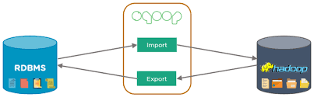
Apache Sqoop
Analytical processing using Hadoop requires loading of huge amounts of data from diverse sources into Hadoop clusters. This process of bulk data load into Hadoop, from heterogeneous sources and then processing it, comes with a certain set of challenges. Maintaining and ensuring data consistency and ensuring efficient utilization of resources, are some factors to consider before selecting the right approach for data load.

Slide 4
Apache Sqoop
Sqoop supports data imported into the following services:
HDFS
Hive
HBase –HBase is a non-relational database. It is a columnar and provides fault-tolerant storage and quick access to large quantities of sparse data. It also adds transactional capabilities to Hadoop. Allowing users to conduct updates, inserts and deletes.
Hcatalog
Accumulo

Slide 5
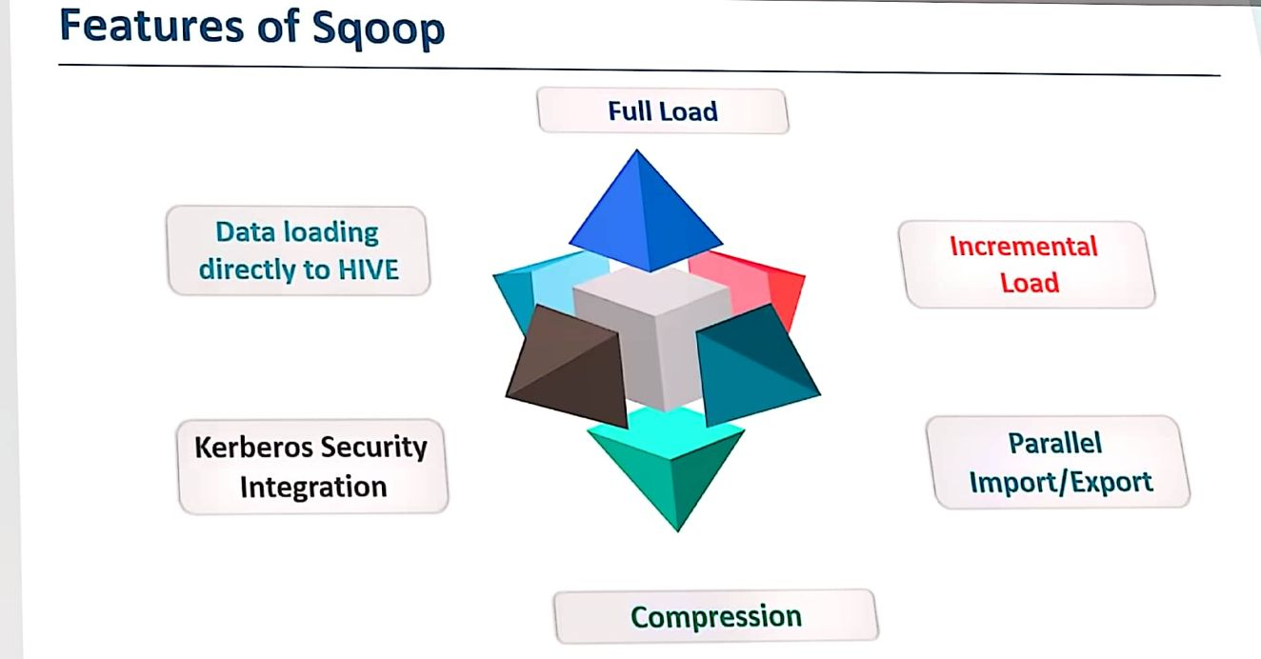

Slide 6
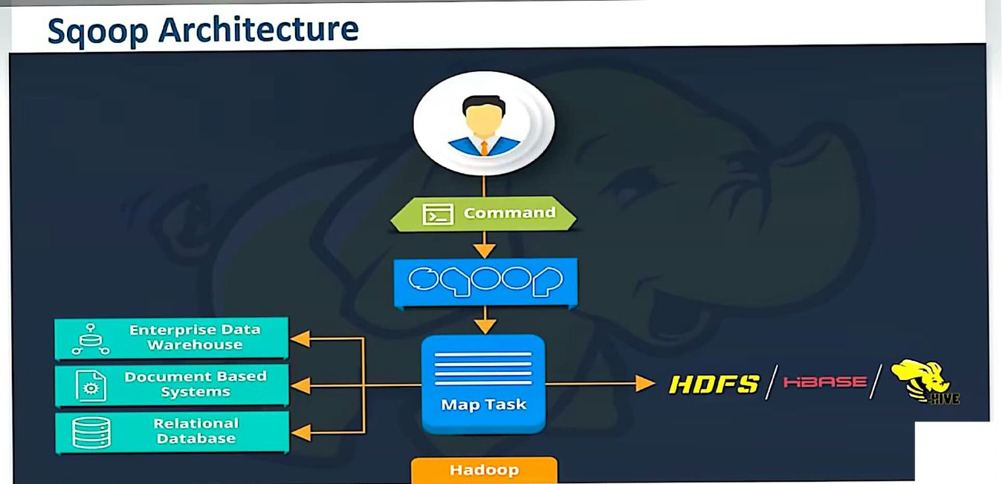

Slide 7
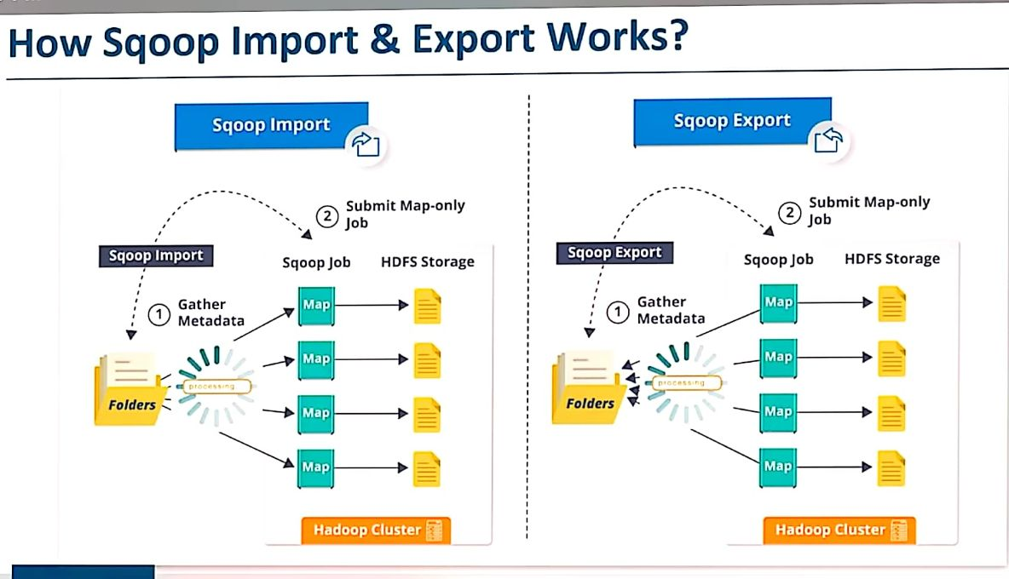

Slide 8
Apache Flume
Apache Flume is a tool for data ingestion in HDFS. It collects, aggregates and transports large amount of streaming data such as log files, events from various sources like network traffic, social media, email messages etc. to HDFS. Flume is a highly reliable & distributed.
The main idea behind the Flume’s design is to capture streaming data from various web servers to HDFS. It has simple and flexible architecture based on streaming data flows. It is fault-tolerant and provides reliability mechanism for Fault tolerance & failure recovery.

Slide 9
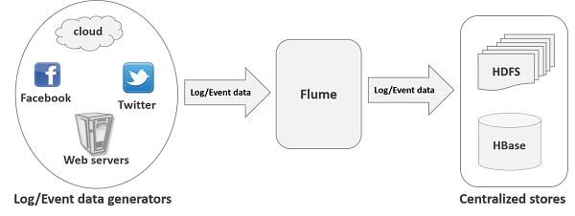
Apache Flume: Architecture
The flume agent has 3 components: source, sink and channel.
Source: It accepts the data from the incoming streamline and stores the data in the channel.
Channel: In general, the reading speed is faster than the writing speed. Thus, we need some buffer to match the read & write speed difference. Basically, the buffer acts as a intermediary storage that stores the data being transferred temporarily and therefore prevents data loss. Similarly, channel acts as the local storage or a temporary storage between the source of data and persistent data in the HDFS.
Sink: Then, our last component i.e. Sink, collects the data from the channel and commits or writes the data in the HDFS permanently.

Slide 10
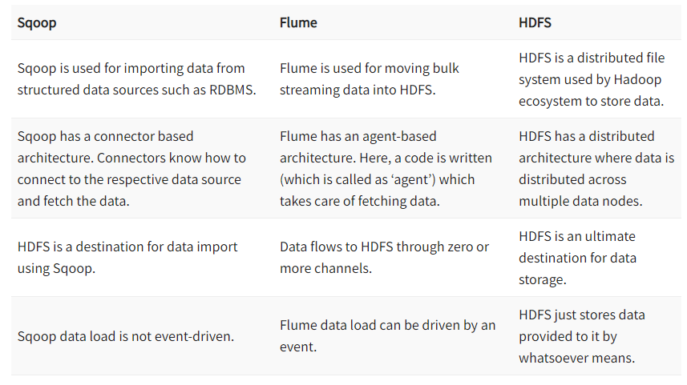
Apache Sqoop , Flume and HDFS

Slide 11
Apache Pig
Pig is an abstraction over MapReduce. Pig runs on Hadoop. So, it makes use of both the Hadoop Distributed File System (HDFS) and Hadoop’s processing system, MapReduce. Data flows are executed by an engine. It is used to analyze data sets as data flows. It includes a high-level language called Pig Latin for expressing these data flows.
Apache Pig was designed by Yahoo as it is easy to learn and work with. So, Pig makes Hadoop quite easy. Apache Pig was developed because MapReduce programming was getting quite difficult and many MapReduce users are not comfortable with declarative languages. Now, Pig is an open-source project under Apache.

Slide 12
Apache Pig
Features of Apache Pig:
For performing several operations Apache Pig provides rich sets of operators like the filters, join, sort, etc.
Easy to learn, read and write. Especially for SQL-programmer, Apache Pig is a boon.
Apache Pig is extensible so that you can make your own user-defined functions and process.
Join operation is easy in Apache Pig.
Fewer lines of code.
Apache Pig allows splits in the pipeline.
The data structure is multivalued, nested, and richer.
Pig can handle the analysis of both structured and unstructured data.

Slide 13
Apache Pig
Applications of Apache Pig:
For exploring large datasets Pig Scripting is used.
Provides the supports across large data-sets for Ad-hoc queries.
In the prototyping of large data-sets processing algorithms.
Required to process the time sensitive data loads.
For collecting large amounts of datasets in form of search logs and web crawls.
Used where the analytical insights are needed using the sampling.

Slide 14
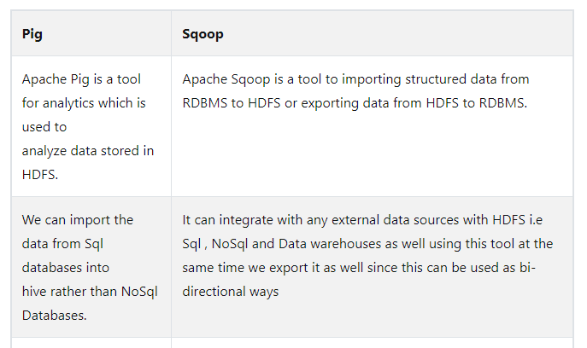
Apache Sqoop Vs Pig

Slide 15
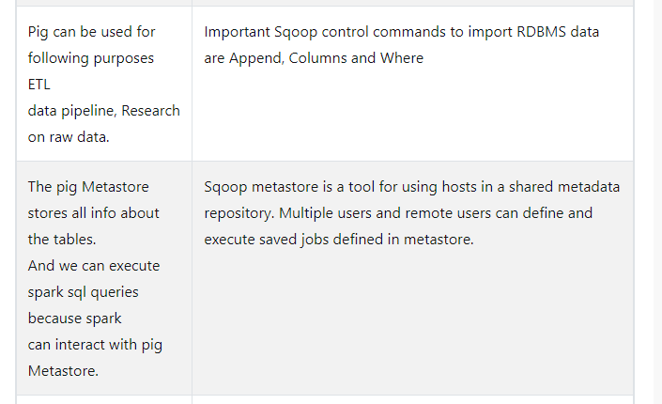
Apache Sqoop Vs Pig cont….

Slide 16
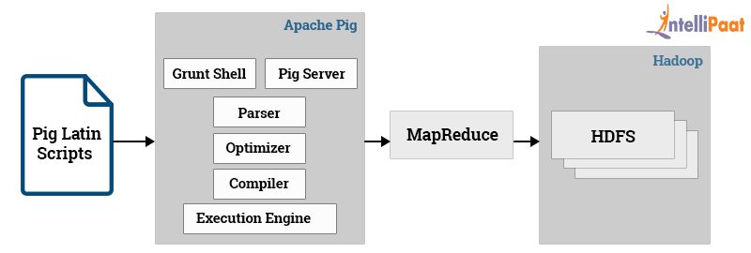
Apache Pig

Slide 17
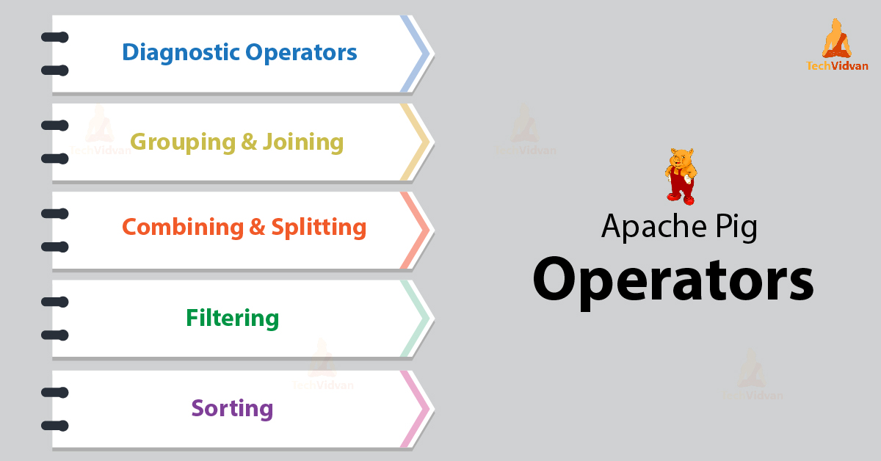

Slide 18
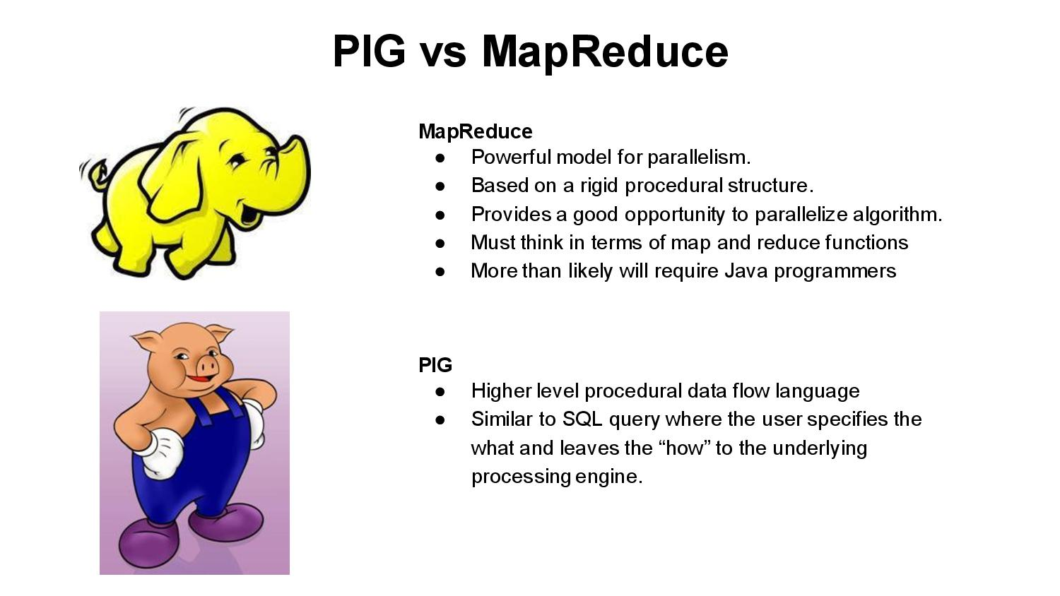

Slide 19
Apache Hive
The Apache Hive is a data warehouse software that lets you read, write and manage huge volumes of datasets that are stored in a distributed environment using SQL. It is possible to project structure onto data that is in storage. Users can connect to Hive using a JDBC driver and a command-line tool.
Hive is an open system. We can use Hive for analyzing and querying in large datasets of Hadoop files. It’s similar to SQL. The present version of Hive is 0.13.1.

Slide 20
Apache Hive
Hive supports ACID transactions: The full form of ACID is Atomicity, Consistency, Isolation, and Durability. ACID transactions are provided at the row levels, there are Insert, Delete, and Update options so that Hive supports ACID transactions.
Hive is not considered a full database. The design rules and regulations of Hadoop and HDFS put restrictions on what Hive can do.

Slide 21
Apache Hive
data warehouse applications
Analyzing the relatively static data
Less Responsive time
No rapid changes in data.
Hive doesn’t provide fundamental features required for OLTP, Online Transaction Processing. Hive is suitable for data warehouse applications in large data sets.

Slide 22
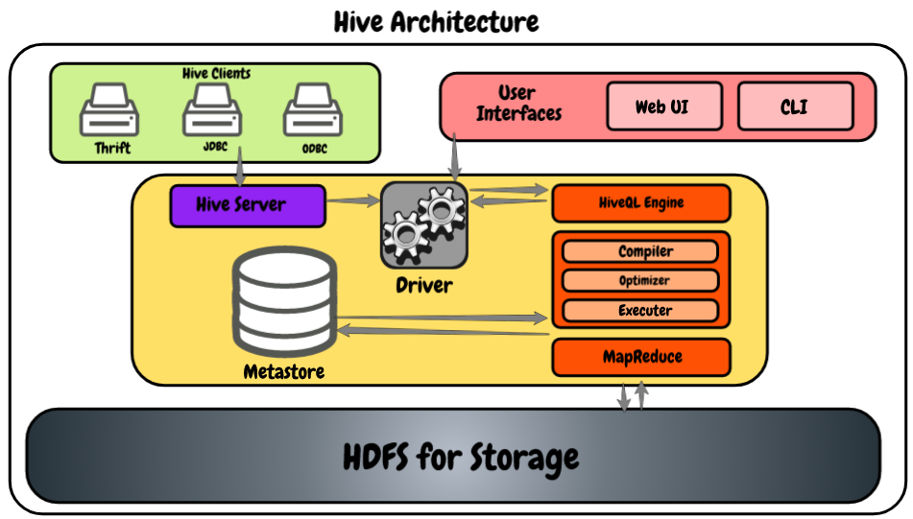

Slide 23
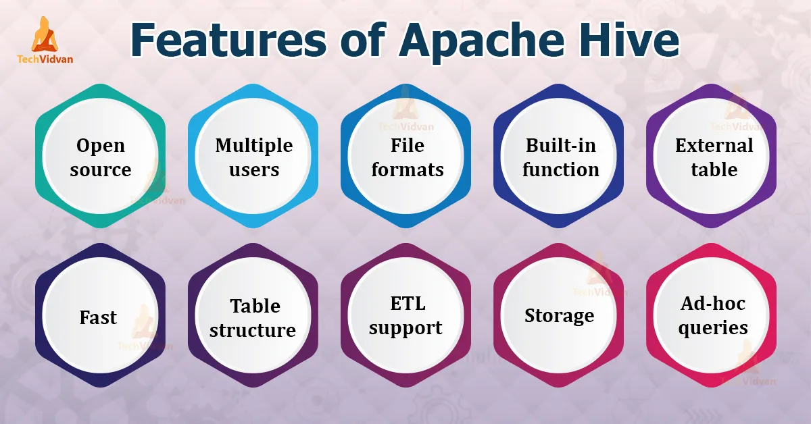

Slide 24
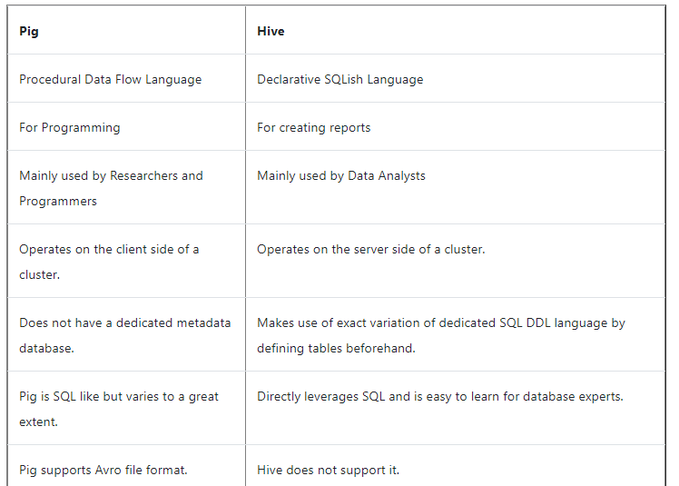

Slide 25
Thank you

